Slide 1
Our Transformation
Casper von Koskull, President and Group CEO
Torsten Hagen Jørgensen, Group COO and Deputy CEO
London, 27th October, 2017

Slide 2
Q3 2017 Group financial highlights
Q3/17 vs. Q3/16*
Q3/17 vs. Q2/17*
 | Total revenues Net Interest Income Fee and Commission Income Net Fair Value | -4% +1% +3% -26% | -1% +1% -4% -1%
 | Total expenses Staff costs | +2% +2% | -7% -5%
 | Loan loss level Impaired loans | 10 (16) bps 174 bps (163 bps) | 10 (13) bps 174 bps (172 bps)
 | CET1 ratio ROE C/I | 19.2% (17.9%) 10.5% (11.6%) 51% (48%) | 19.2% (19.2%) 10.5% (9.5%) 51% (54%)
Income
Costs
Credit quality
Key ratios
* In local currencies and excluding non-recurring items

Slide 3
Our Transformation

Slide 4
Transformation summary
Significant progress has been made over the last two years
Material improvement in overall Resilience, including measurably strengthened 2nd & 3rd line and Core Systems
Digital platform strengthened to remain relevant towards Customers
Successful Legal Structure Project and stronger balance sheet, improved credit quality and further strengthening of ancillary income
Embarking on a full fledged transformation journey
We are re-inventing banking from a position of strength; large customer base, strong balance sheet with ability to invest in the future
Nordea’s operating model will be Scalable, Agile and Resilient and will provide the foundation for winning in the marketplace
The Transformation also delivers significant improvement in efficiency, profitability and capital generation
Target of total costs incl. transformation costs < EUR 4.8bn in 2021
Continued significant CET1 accumulation and robust outlook for delivering on our dividend policy
Continued improvement of RoE

Slide 5
Nordea has the largest financial services platform in the Nordics
Nordea at a glance
Nordic region
Well diversified
11 million customers
10 million household customers
540,000 corporate & institutional customers
Operating in the 10th largest economy in the world
Distribution power through 600 locations and 7 million Netbank customers
Strong financial position
EUR 10bn in full year income (2016)
EUR 615,3bn of assets (Q3 2017)
EUR 32,3n in equity capital (Q3 2017)
Common Equity Tier 1 Capital ratio of 19.2% (Q3 2017)
~ EUR 46,3bn in market cap
One of the largest Nordic corporations
A top-10 universal bank in Europe
Income distribution FY’16
Nordea Group
Market position
Other
Corporate & Institutions
#1
7%
PeB
WM
30%
21%
Households
#1
23%
19%
WB
CBB
Sweden
Other
Finland
12%
Sweden
25%
Norway
Denmark
29%
19%
16%
Finland
Denmark
Norway
Source: Nordea Annual Report 2016 and Nordea Second Quarter Results 2017
Note: The Board of Nordea Bank AB (publ) has decided to initiate a process to re-domicile to Finland. For further details please visit https://www.nordea.com/Images/33-202209/Debt%20Investor%20Presentation%20Q2%202017.pdf

Slide 6
A robust balance sheet and stable profit generation
Steady capital accumulation…
… and a stable business model
CET1, %
Income structure less reliant on NII
19.2
100%
16.5
Net interest income
15.7
14.9
Ancillary income
13.1
²
2008
A2017
11.2
10.3
10.3
Less volatile profit generation
Quarterly net profit volatility, 2006 – 2016, %¹
8.5
7.5
2007
2008
2009
2010
2011
2012
2013
2014
2015
2016
2017 Q3
Nordea
Peer 1
Peer 2
Peer 3
Peer 4
Peer 5
Calculated as quarter on quarter volatility in CET1 ratio, adjusted so that the volatility effect of those instances where the CET1 ratio increases between quarters are excluded
9 months annualised

Slide 7
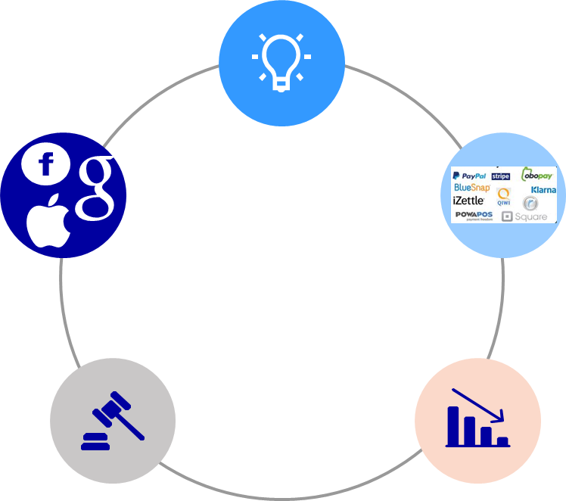
We face strong external and internal forces – change is underway
External forces driving a need for change
Internal forces driving a need for change
Underlying cost pressure
REGULATORY ENVIRONMENT
Large investments in transformation causing:
Increased running costs
Increased depreciations and amortisations
TECHNOLOGY
DIGITAL
MOBILE
AI/ROBOTICS
SOCIAL MEDIA
CLOUD
CHANGING COMPETITIVE LANDSCAPE
2018
2021
Need for “Common Model”
CHANGING CUSTOMER BEHAVIOUR AND EXPECTATIONS
Common operating model needed to address the complex structure from multi-country and multi-regulator set-up
Nordea today
One Nordea
External environment = VUCA
Volatility
Uncertainty
Complexity
Ambiguity
Flexibility & optionality critical in organisation

Slide 8
Our ambition is to be the Future Relationship Bank
We need certain key attributes …
+
… alongside an all-pervasive customer focus …
=
… to become the Future Relationship Bank
Efficient and Scalable
Easy to deal with
Customer satisfaction primary driver in everything the bank does
Cost competitive + Reduction of complexity
Anywhere and anytime
Fast and Agile
Outside-in perspective creating customer focus across organisation
Meeting evolving customer needs + Acting on business opportunities and treats
Relevant and competent
Resilient and compliant
Enables bank to innovate and stay relevant
Stable and trustworthy
Balance sheet robustness + Adapting to changing regulatory environment

Slide 9
We are ready to take the next step in our transformational journey
Illustrative timeline
Success factors
RAMP UP (2015 – 2017)
3
Ambitious investments to build the foundation
Fast & agile
Efficient and Scalable
Resilient and compliant
OPTIMISATION
1
EXECUTION (2018 – 2021)
2
Distribution/Channels/Service model
Credit Processes & Products
IT & Ops
Key support functions
EXECUTION
2
1
OPTIMISATION (2021 - )
RAMP UP
3
Future relationship bank
2015 - 2017
2018 - 2021
2021 -

Slide 10
Financial outlook
INCOME
Expected to grow with nominal Nordic GDP
COSTS
Costs up 3-5% in 2017 vs 2016 excl. transformation costs of EUR 100-150m
Cost base of approx. EUR 4.9bn in 2018
Target of total costs incl. transformation costs < EUR 4.8bn in 2021
CAPITAL
Continued significant CET1 accumulation
Robust outlook for delivering on our dividend policy
RoE
Continued improvement of RoE
Target to be above the Nordic peer average

Slide 11
The lending portfolio is being focused towards the core Nordic market with reduced risk
More focused lending portfolio while at the same time reduced complexity
Regional split
Non- Nordic
Non-Nordic regions down by ~40%
Baltics
Joint venture with DNB in the Baltics
Create a competitive and bank with scale
Nordea remain as shareholder
Russia
Scale down of the business in favour for Nordic corporate focus
Divestment of Retail portfolio
Poland (divested in ’13)
Not in line with the relationship strategy
Regulatory risks
Risky segments down by 10%
Exposure toward segments such as shipping, oil and agriculture expected to be further reduced over coming years
95%
97%
Nordic
2015
2017H1
2021E
Risk profile
High
6%
5%
Medium
Low
2015
2017H1
2021E
Notes: High Risk: Rating/scoring 0- to 2+/E+, Medium Risk: Rating/scoring 3-/D- to 4+/C+ and unrated, Low Risk: Rating/scoring 5-/B- to 6+/A+.
Sovereign exposures, lending to central banks and repos excluded. Non-nordic consist of Baltics (carve-out) and Russia

Slide 12
We are significantly reducing the risks
Risk
Trends
Mitigating actions
Business
Digitalisation
Regulatory pressure
Build up of Digital capabilities and renovation of digital engine
Streamlined organisation and reshaping distribution model
Centre of Excellence for managing, protect and usage of Data
Operational
Compliance
Cyber risks and IT stability
Execution (change portfolio)
Competence upgrade in 1st, 2nd and 3rd line
IT Governance and Operational risk framework
CoE and road map for managing Cyber risks
Future IT: Cloud, Digital Workspace, Devops and Agile
Standardization of components and solutions
Group wide prioritisation process of development portfolio

Slide 13
Ambitious investments in building key attributes have been done
Illustrative timeline
Success factors
RAMP UP (2015 – 2017)
3
Ambitious investments to build the foundation
Fast & agile
Efficient and Scalable
Resilient and compliant
OPTIMISATION
1
EXECUTION (2018 – 2021)
2
Distribution/Channels/Service model
Credit Processes & Products
IT & Operations
Key support functions
EXECUTION
2
1
OPTIMISATION (2021 - )
RAMP UP
3
Future relationship bank
2015 - 2017
2018 - 2021
2021 -

Slide 14
Ambitious ramp-up with large investments to build key attributes
Development spend (gross*)
Comments
Development spend and Capitalisation expected to peak in 2017
IT related intangible assets expected to peak in 2020 (at approx. 2.5EURbn) and depreciation & amortisations in 2021
We invest in …
… to build our key attributes
Digital
Fast and Agile
Simplification
Efficient and Scalable
Compliance & Resilience
Resilient and compliant
Note “Other” includes initiatives related to cost efficiency, income growth and other BA/function priorities
*Gross spend, financial effects both on P&L and capitalisation

Slide 15
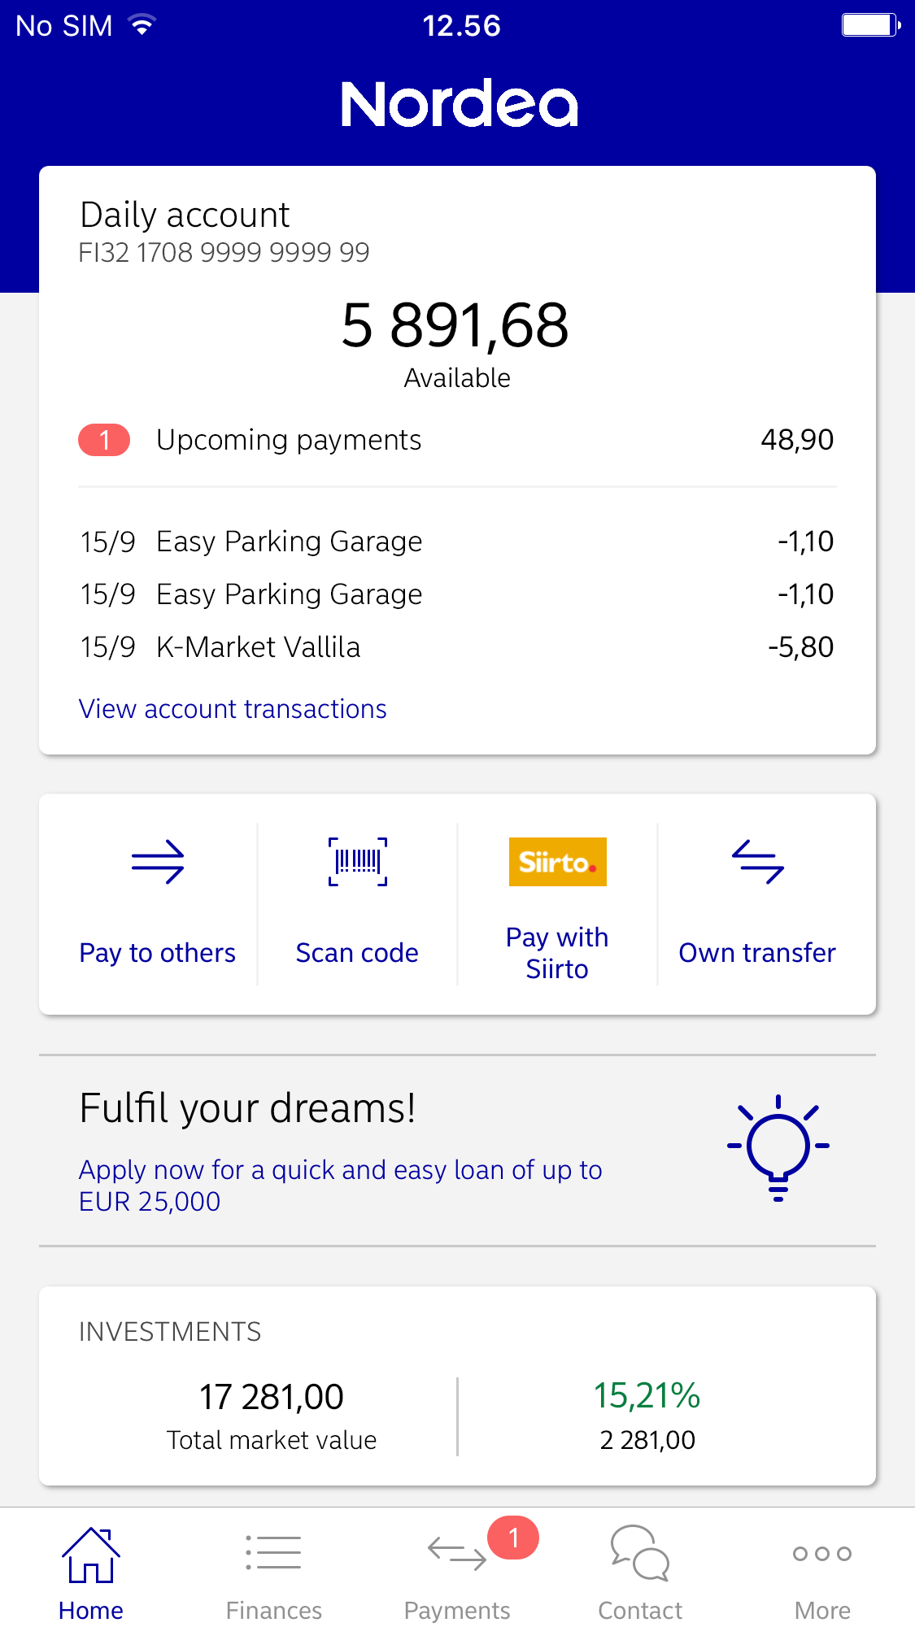
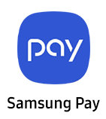
Fast and agile – positioning the mobile in the center
Fast and Agile
Efficient and Scalable
Resilient and compliant
Online and face-to-face
meetings
Aggregated open banking services
Chat,
chatbots,
calls – 24/7
Global wallets
Mobile as entry point to all services
Local providers
15
Mobile banking app screen represents a beta version
Notes:
The mobile bank is increasingly becoming the first point of entry for millions of our customers. Our mobile wallet partnership with Samsung is followed by one with Apple, which increases the number of customers that can make purchases through their mobile phones. We have also entered into collaboration with the Norwegian payment app Vipp.
The use of artificial intelligence - AI - will enable enhancing customer experience. A customer service chatbot was presented in Norway in September and has been accessed more than 7 000 times and answered over 10 000 questions from both personal and corporate customers.
In December we will be launching a web based robot adviser, which will allow for investment and savings advice wherever and whenever it suits the customer best. Among many things that we focus on in order to improve the customer experience are quicker response times and increased accessibility. Our digital solutions allow customers to be one click away from meetings with advisors. One out of five customer meetings is held online, an increase with 21% compared to one year ago.

Slide 16
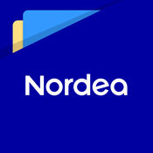
Fast & Agile
Fast and Agile
Efficient and Scalable
Resilient and compliant
Digital Sales
Opened totally renewed and modern open pages e-commerce shop (Nordea.xxx)
Personalised online messages generating sales
Nordea Digital Web (Corporate)
Delivered first version of Nordea Digital Corporate
Easy day-to-day banking together with integrated remote support and advice
Nordea Digital Foundation Platform
Modern Java microservices based platform powering new mobile/web applications, live in Sweden and Finland
Nordea Digital Markets
Upgraded next generation FX e-Commerce platform, e-Markets (mobile FX trading for corporate segment)
Auto FX solution - awarded for Product Innovation in Global Finance’s The Innovators awards for 2017
Open Banking
Invited >800 companies to collaborate in a sand box environment
First in the Nordic market with Open Banking

Slide 17
Efficient and Scalable
Fast and Agile
Efficient and Scalable
Resilient and compliant
Core Banking Platform
Robotics
Building capabilities and automating processes across the Group
Number of robots in production approaching 200. First chatbot (AI) live in Norway
Deployments is expected reach full potential by mid 2019.
Exploration of first automation capacity to on-board cognitive technologies.
Progressing according to plan and on the brink of first major customer release
T24 Model Bank configured for Nordea and installed on infrastructure
Finnish staff pilot for a fixed term deposit product launched
Cloud
Other Simplification
Integrated Global Payment Engine and migrated all SEPA Interbank payments
Centralised data mgmt. and development of common data infrastructure
Core system upgrades in Nordea Finance and Nordea Life & Pension DK
Reducing complexity (Trading & Risk area and Safekeeping)
Elastic backend infrastructure and development of business solutions
Software as a Service
Agile development by combining Platform as a Service with cloud development
Employee productivity by implementing Office 365

Slide 18
Resilient and Compliant
Fast and Agile
Efficient and Scalable
Resilient and compliant
Compliance & Operational risk
Financial Crime
Capacity upgrade in 1st, 2nd and 3rd line
Implementation of new code of conduct and business continuity framework
Enforcing the Crisis management governance and capabilities
Comprehensive training and certifications of key staff
Significant build up of group wide financial crime organization
Global KYC and Sanctions standards implemented
Centralizing and optimizing KYC & AML operations
Enterprise Risk Assessment framework delivered, full implementation 2018
Technology & Infrastructure
IT remediation
Enhanced Information and Cyber security strategy and response capabilities
Insourcing of IT operations
Full data-centre fail over test
Integrated end-2-end Technology Operations and Support organsation
One PreProduction site in Finland established
Global Enterprise Identity & Access Rights Management control system
Roll-out of Malware Detection & Global Fraud Monitoring across Nordic
IT Control Assurance Framework rolled out

Slide 19
Execution is about enhancing core competiveness through very specific initatives
Illustrative timeline
Success factors
RAMP UP (2015 – 2017)
3
Ambitious investments to build the foundation
Fast & agile
Efficient and Scalable
Resilient and compliant
OPTIMISATION
1
EXECUTION (2018 – 2021)
2
Distribution/Channels/Service model
Credit Processes & Products
IT & Operations
Key support functions
EXECUTION
2
1
OPTIMISATION (2021 - )
RAMP UP
3
Future relationship bank
2015 - 2017
2018 - 2021
2021 -

Slide 20
Expected cost development 2017-2021
Comments
350-400 ~225-250 in 2018
Significant underlying cost pressure of 600-700m driven by:
Increasing running expenses for IT systems following the substantial development agenda/digital transformation and compliance
Annual underlying salary increases and inflation on non-staff expenses
Increasing depreciations & amortisations following substantial product/investments in IT infrastructure / solution platforms
Gross savings driven by transformation, as well as lower project costs, more than counteracting the upward pressure
~300
~300-400
-150
~5,100-5,200
50
-75
<4,800
-900
Estimated 2017 Cost incl. Transformational costs
Baltics & Re-domicilation
Run cost effects of 2015-17 ramp-up, reinvestments and inflation
Depreciation & Amortisation
Group projects ramp-down
Transformational driven gross savings
2021 Cost incl. Transformational costs
20

Slide 21
Gross cost savings of around 900 EURm expected through transformation
Estimated savings effects*
Distribution/ Channels/ Service model
Ramp up speed of migration to digital (mobile), remote meetings, and closing down branches
Segmentation and stronger Nordic coordination of client coverage and build up of global competence center
~ 30%
(~250 EURm)
Credit processes & Products
Implementation of pre-approved credit limits and automated credit decisions
Functional centralisation to achieve’ scale and enhanced capacity
Implementation of common standards for risk assessments
Strict product prioritisation, production location (in-house, outsourced or white labelled) and centralise workforce/processes to improve efficiency
~ 15%
(~150 EURm)
Information Technology & Operations
Higher degree of centralisation and nearshoring/outsourcing and shared platforms
Automatization and Robotics
Reduce complexity and establish future technological platform
~ 45% (~400 EURm)
Key support functions
Optimised service model for People (i.e. Learning), Finance and consolidation of support staff
Higher degree of nearshoring in relevant areas
Streamlining sourcing strategy
~ 10% (~100 EURm)
Total
100% (~900 EURm)
* Numbers rounded to closest 5%

Slide 22
FTE and consultants effects (incl cost to transform)
Comments
The transformation will include a reduction of FTEs of >4.000
New hirings to support competence shift and centralisation
Number of consultants to be reduced by ~2.000 over the 2017-2021 period
The transformation is expected to generate a total cost to transform of ~5-600m over the 2017-2021 period
Absolute majority of cost to transform consists of redundancy costs
The costs are mainly related to:
Transformation of Personal Banking and CBB including the migration to Digital
IT & Operations (nearshoring and automation & process optimisation)
>6 000
~2000
Consultants
Gross reductions
New hirings
Net reductions

Slide 23
Expected financial performance development towards 2021
RoCaR/RoE
Cost / Income
Est. FY 2017
Est. chg. 21/17
Est. FY 2017
Est. chg. 21/17
PeB
Gradually improved Group return and cost efficiency as areas address and close their relative performance gaps
~16%
~52%
CBB
~8%
~58%
WB
~9%
~43%
WM
~32%
~45%
Nordea Group
~10%
~53%
* Note: WM interim perspective. 2017 numbers based on annualised figures per ytd annualized

Slide 24
Personal Banking
Key transformation initiatives
Cost efficiencies and quality gains
Improved customer value through evolving mobile offering and partnerships
Establish the mobile as the main tool for interaction
Encourage digital sales and distribution by using analytics based digital cross selling and onboarding
Customers are increasingly requesting online meetings on behalf of face-2-face meetings
Optimization of distribution network
Serve all customers through a digital (mobile)-first, lean core offering, which caters to the needs of most customers and delivers scalability
Focus on high-value customers (Homeowners and Affluents) with tailored value propositions added on top of the lean core offering
Streamline the service processes
Reduce costs in processing e.g., through automation of product processing, nearshoring, robotics and lean, including automating front-office processes to allow reduction of Customer Service Officers
Implement agile way of working at scale across the value chain improving time-to-market and productivity
Where do the cost efficiencies come from?
Distribution/ Channels/ Service model
High
IT & Operations
Medium
Credit proc. & Prod.
Medium
Key support functions
Medium
Increased efficiency
Material reduction of costly f2f meetings by increasing remote meeting proportion from ~20% to >60%
Reduction in advisor FTEs and Customer Service Officers aligned with branch reduction, enabled by digitalization and centralization
Increased customer satisfaction
Streamlined and efficient service provision to mass market
Freeing up time for more dedicated service to high-value customers allowing time for tailored solutions

Slide 25
Commercial & Business Banking
Key transformation initiatives
Cost efficiencies and quality gains
Digital disruption and future capabilities
Payment Strategy is critical for Nordea’s ability to compete in a disrupted banking market
Partnerships and co-creation models in a new market environment
Executing the Target Operating Model
A more streamlined and efficient organisation
Optimised portfolio size per advisor in order to serve customers more cost efficiently
Process efficiency gains
Robotics (initial focus on KYC and Operations)
Automation of processes and credit decisions
Pre-approved limits
“Nordea Free” (freeing up time for advisors)
Digital efficiency gains
The ambition is to make the smallest customers (~500k) almost fully self-serviced
Will be implemented through:
New Nordea Digital Corporate platform
Online on-boarding and online meetings
Online credit information gathering and digital signature
Where do the cost efficiencies come from?
Distribution/ Channels/ Service model
High
IT & Operations
Medium
Credit proc. & Prod.
High
Key support functions
Medium
Increased efficiency
Freeing up time with frontline staff by eliminating or automating time consuming / less value adding process steps
Reduced operational risk through improved consistency in credit assessment and decision making
Increased customer satisfaction
Through faster response time of credit decisions and increased quality in advisory since larger part of preparation is automated
Through introduction of new digital solutions and value added services

Slide 26
Wholesale Banking
Key transformation initiatives
Cost efficiencies and quality gains
Business strategy unchanged, #1 relationship bank in the Nordics
Streamlined customer service
Further explore digital channels and services
Re-positioning of Markets
Implement new cross-Nordic operating model for Markets business with stronger customer ownership and clearly defined service and value offerings
Cross-sell and capital markets financing
Operational excellence,
Simplified IT infrastructure, robotics and near-shoring to Poland
Strengthened capital governance and risk management
Increase capital velocity
Consolidate SOO franchise and normalised loan losses
Where do the cost efficiencies come from?
Distribution/ Channels/ Service model
High
IT & Operations
High
Credit proc. & Prod.
Medium
Key support functions
Medium
Operational excellence,
Simplified IT infrastructure, robotics and near-shoring to Poland
Improved customer satisfaction
Client coverage: A more coordinated, dedicated and holistic approach to customer interaction
Research: High uniform quality, easier and more transparent to deal with and utilise pan-Nordic capacity

Slide 27
Wealth Management
Key transformation initiatives
Cost efficiencies and quality gains
Value proposition design and segmentation
More focused service provision to private banking customers (provide right services to the right customers)
Increased thresholds for different service levels
Increased use of outsourcing services
Ensure strong Nordic alignment and scale in service offerings
Optimised operations
Global competence centre creations to increase cost efficiency but also improve quality
Optimise the work between back-office, mid-office and front office support in Private Banking by centralising client on-boarding, reporting and routine services
Accelerate implementation of robot process automatisation and cognitive robotics
Productivity gains from rolling out Agile@scale in private banking
Where do the cost efficiencies come from?
Distribution/ Channels/ Service model
High
IT & Operations
High
Credit proc. & Prod.
Low
Key support functions
Low
Increased efficiency
Improved cost to serve levels through more structured customer focus
Improved customer satisfaction
More structured customer focus and optimised ways of working will support higher service levels for customers willing to pay

Slide 28
Group Functions
Key transformation initiatives
Cost efficiencies and quality gains
Streamlining Operations
Increased automation of operations across all business (e.g. by increased use of robotics)
Improve sourcing competencies including more demand/supply capabilities
Streamlining IT setup
Align future workforce competences and locations to future needs (e.g. higher presence in Poland)
Consolidate and reduce technology infrastructure complexity and applications
Implement and integrate higher use of cloud
Streamlining Business Risk Management
Implement optimised KYC operating model
Streamline and optimise risk reporting and risk assessments
Consolidation key support functions on BA level
Create globally consolidated support model per BA mainly driven by design to cost (move away from country/team focus and focus on shared pool of services)
Where do the cost efficiencies come from?
Distribution/ Channels/ Service model
None
IT & Operations
Very high
Credit proc. & Prod.
Low
Key support functions
Medium
Increased efficiency
Insourcing of consultants
Use of cloud services
Decommissions
Improved service provision
Faster and smarter end-to-end processes
Less operational risk
One way of working
Freeing up time for more value-adding activities (also in customer facing units)

Slide 29
Executing on our transformational agenda will lead to a position of strength
+
=
Strategy
Financial Impact
Non-Financial Impact
Outcome
Investments in Operations
Digitalisation / IT
Cost focus
Increased Business Focus
Poland Exit
JV in Baltics
Russian Scale-down
Optimise Key Business Lines
Asset Management
Consumer Finance
Asset Finance
Income
Cost
Loan losses
Capital generation
ROE
Cust. Sat. Index
Compliance
Resilience / Op Risk
Scale
Strat. Optionality
Flexibility
Optionality
User-friendly
A Bank Fit For Purpose and aligned with its Customers needs and Values

