Slide 2
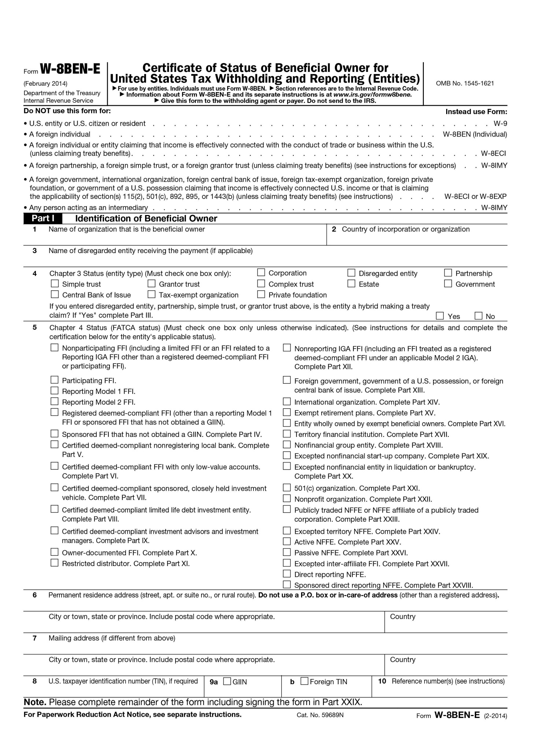
Boxes with red indicate information, which is mandatory information for FATCA
Mandatory if you are a participating FFI, Reporting Model 1 and 2 FFI, registered deemed-compliant FFI , Direct reporting NFFE, trustee of a trustee documented trust, or Sponsored direct reporting NFFE.
Here you shall insert your national TIN

Slide 3
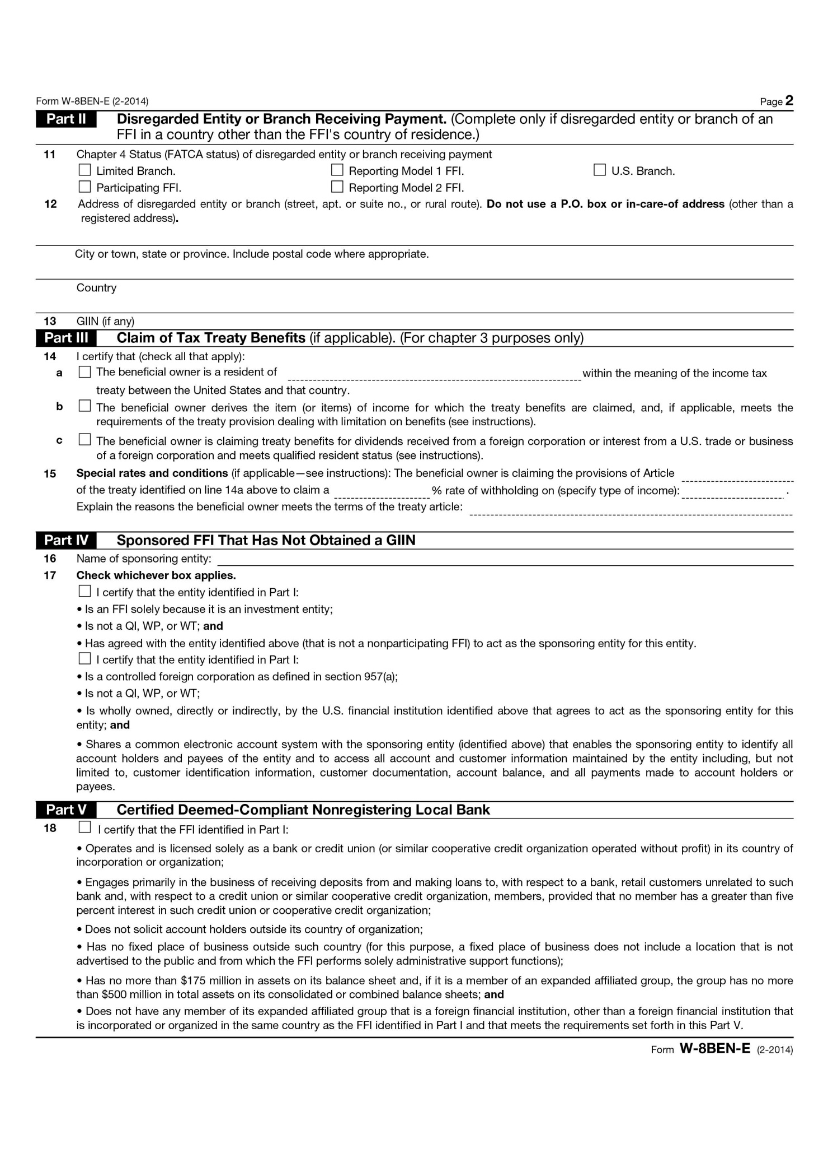

Slide 4
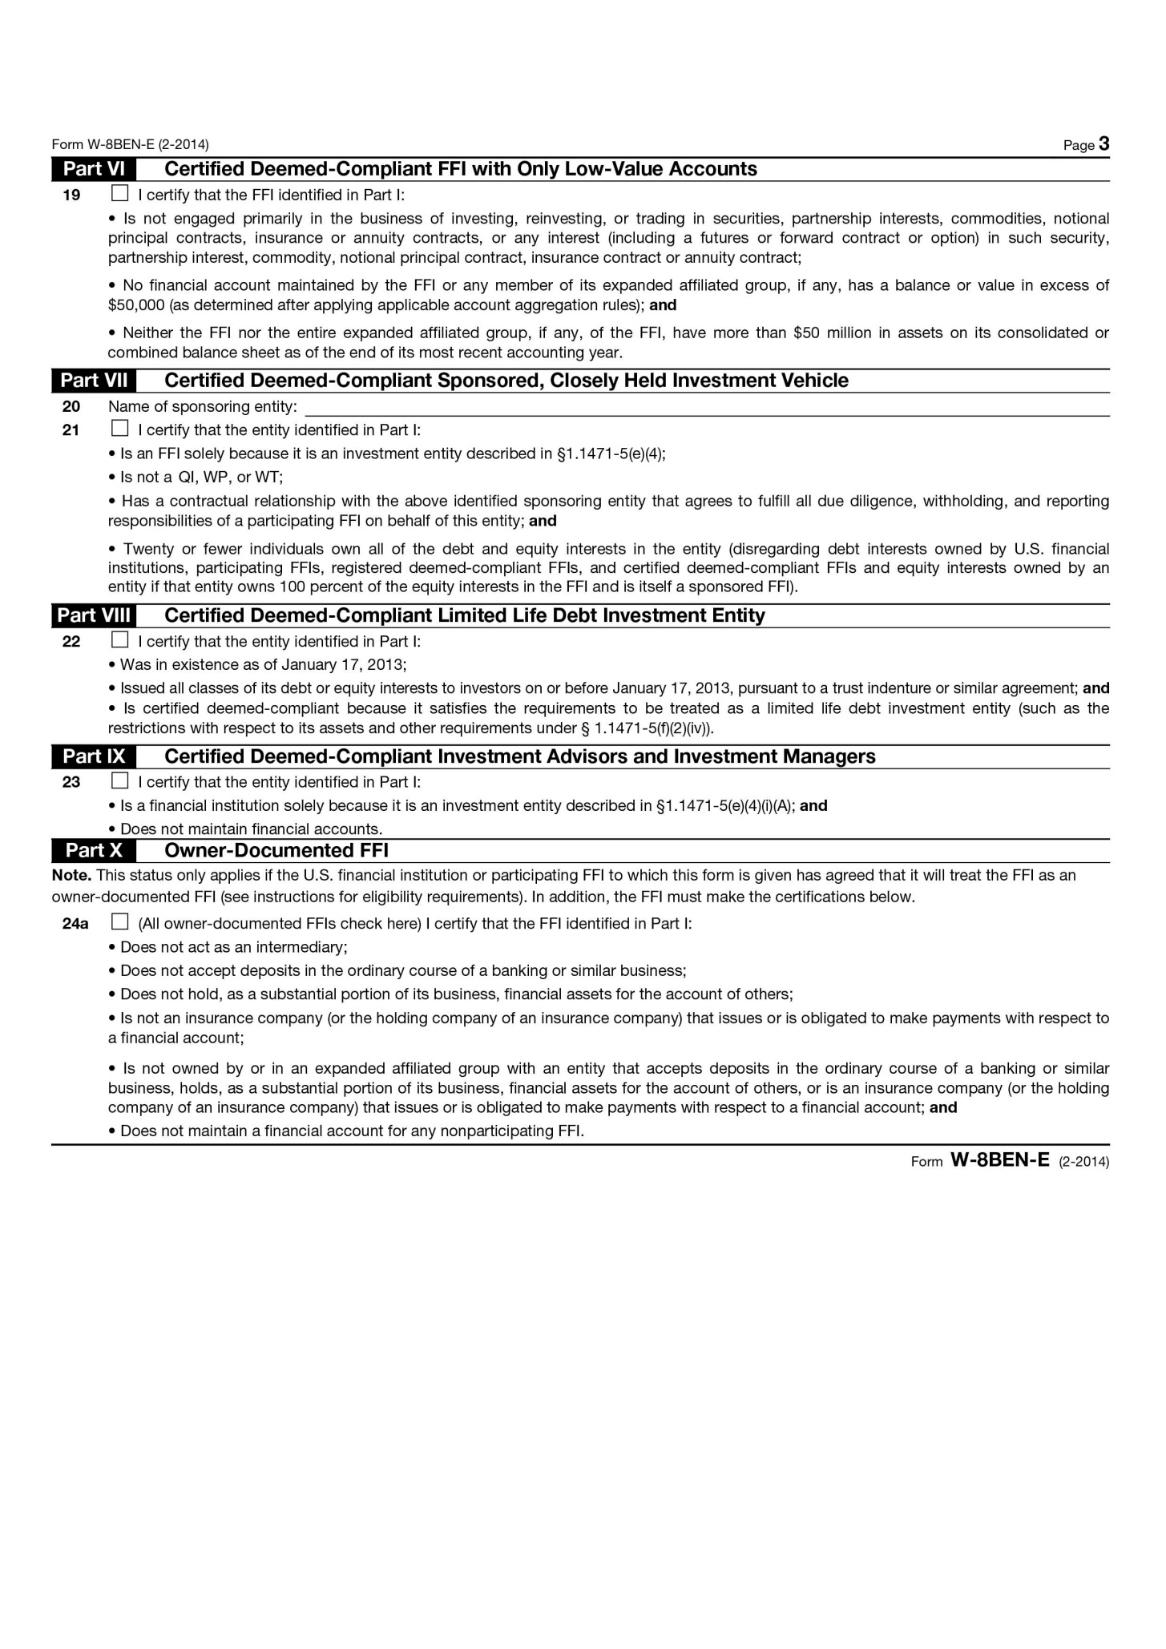

Slide 5
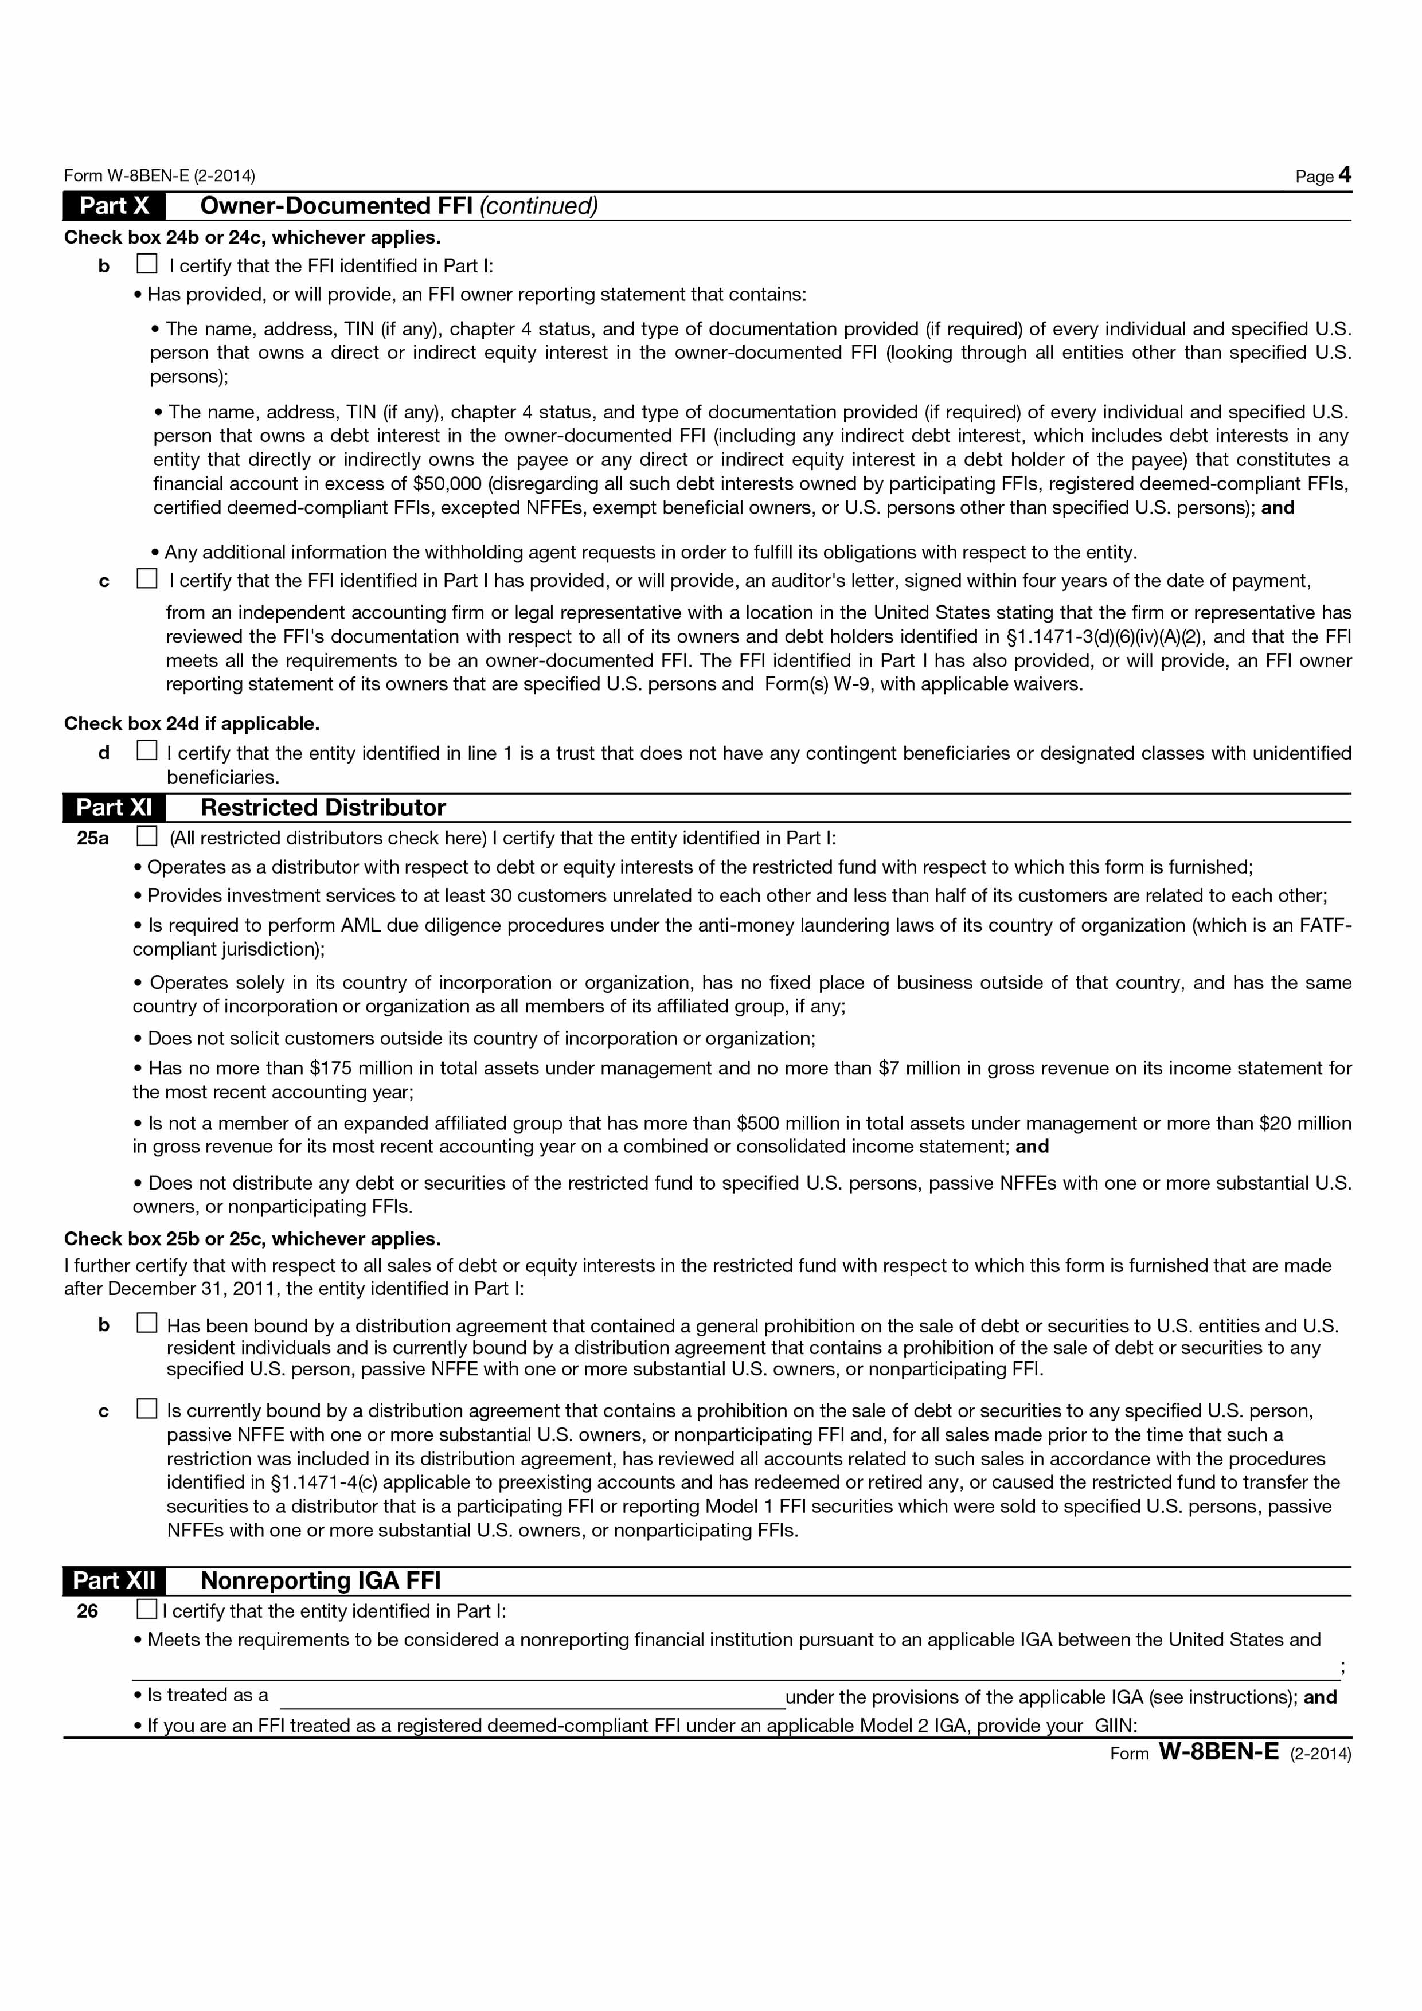

Slide 6
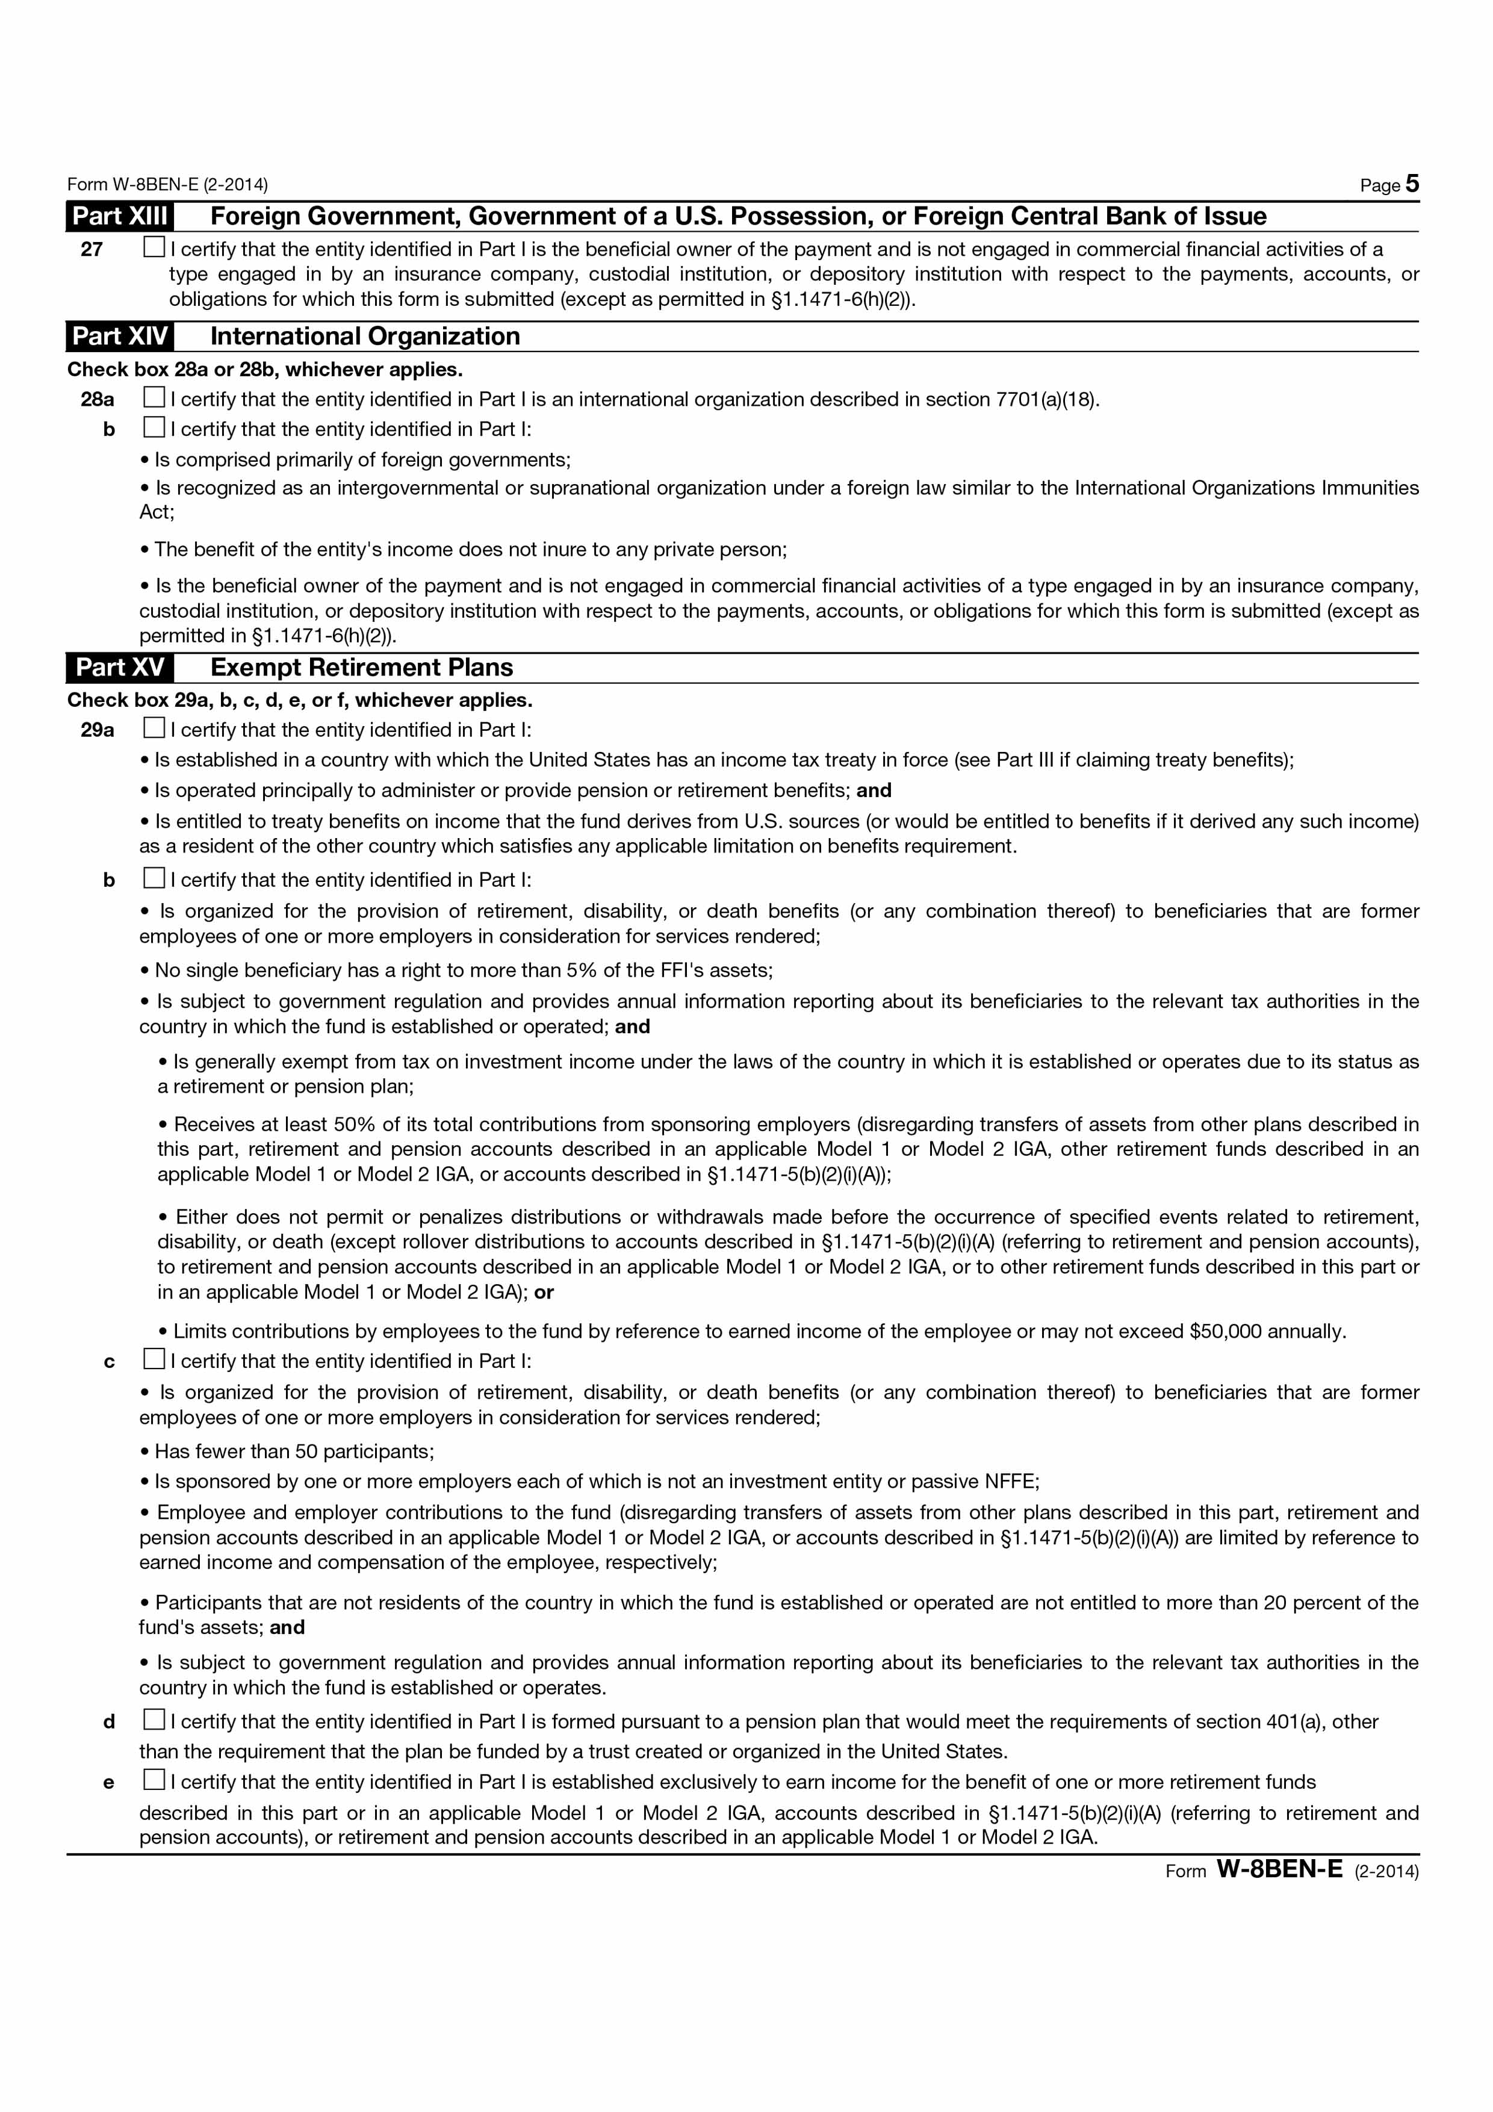

Slide 7
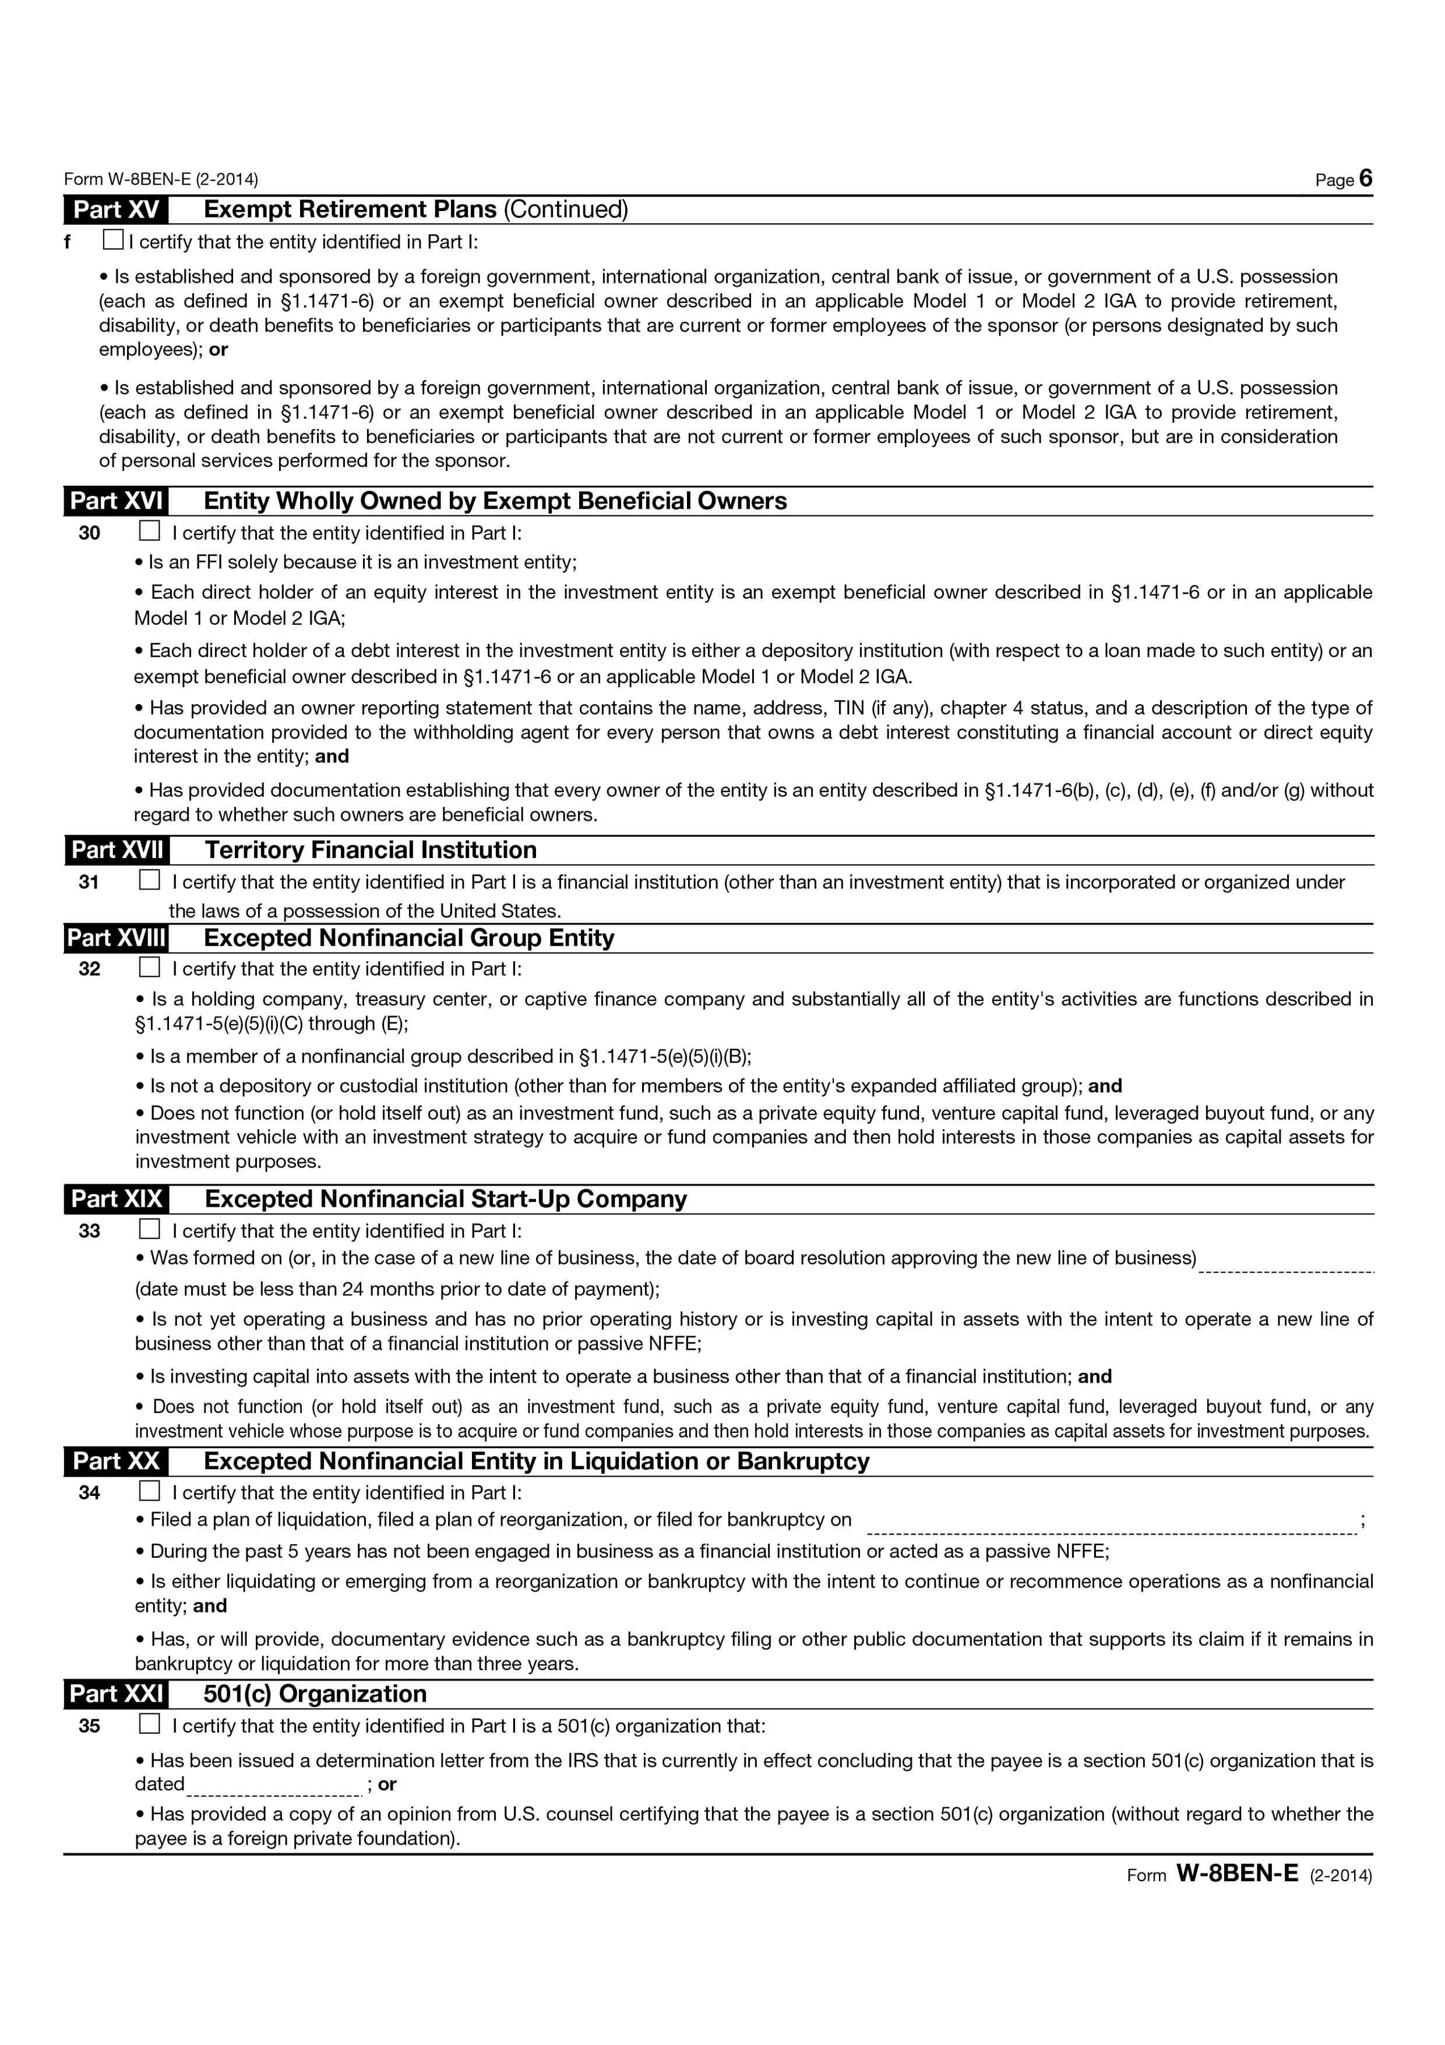

Slide 8
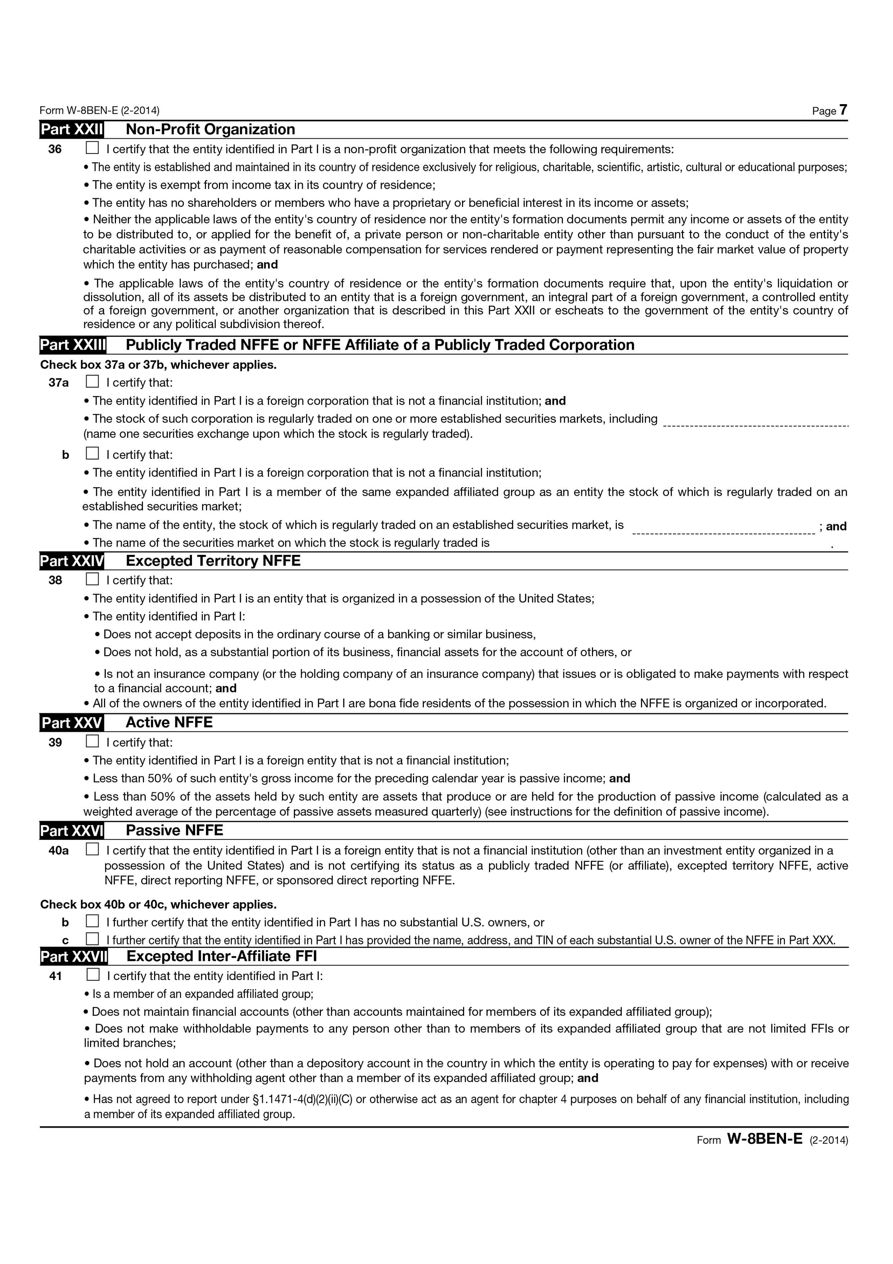

Slide 9
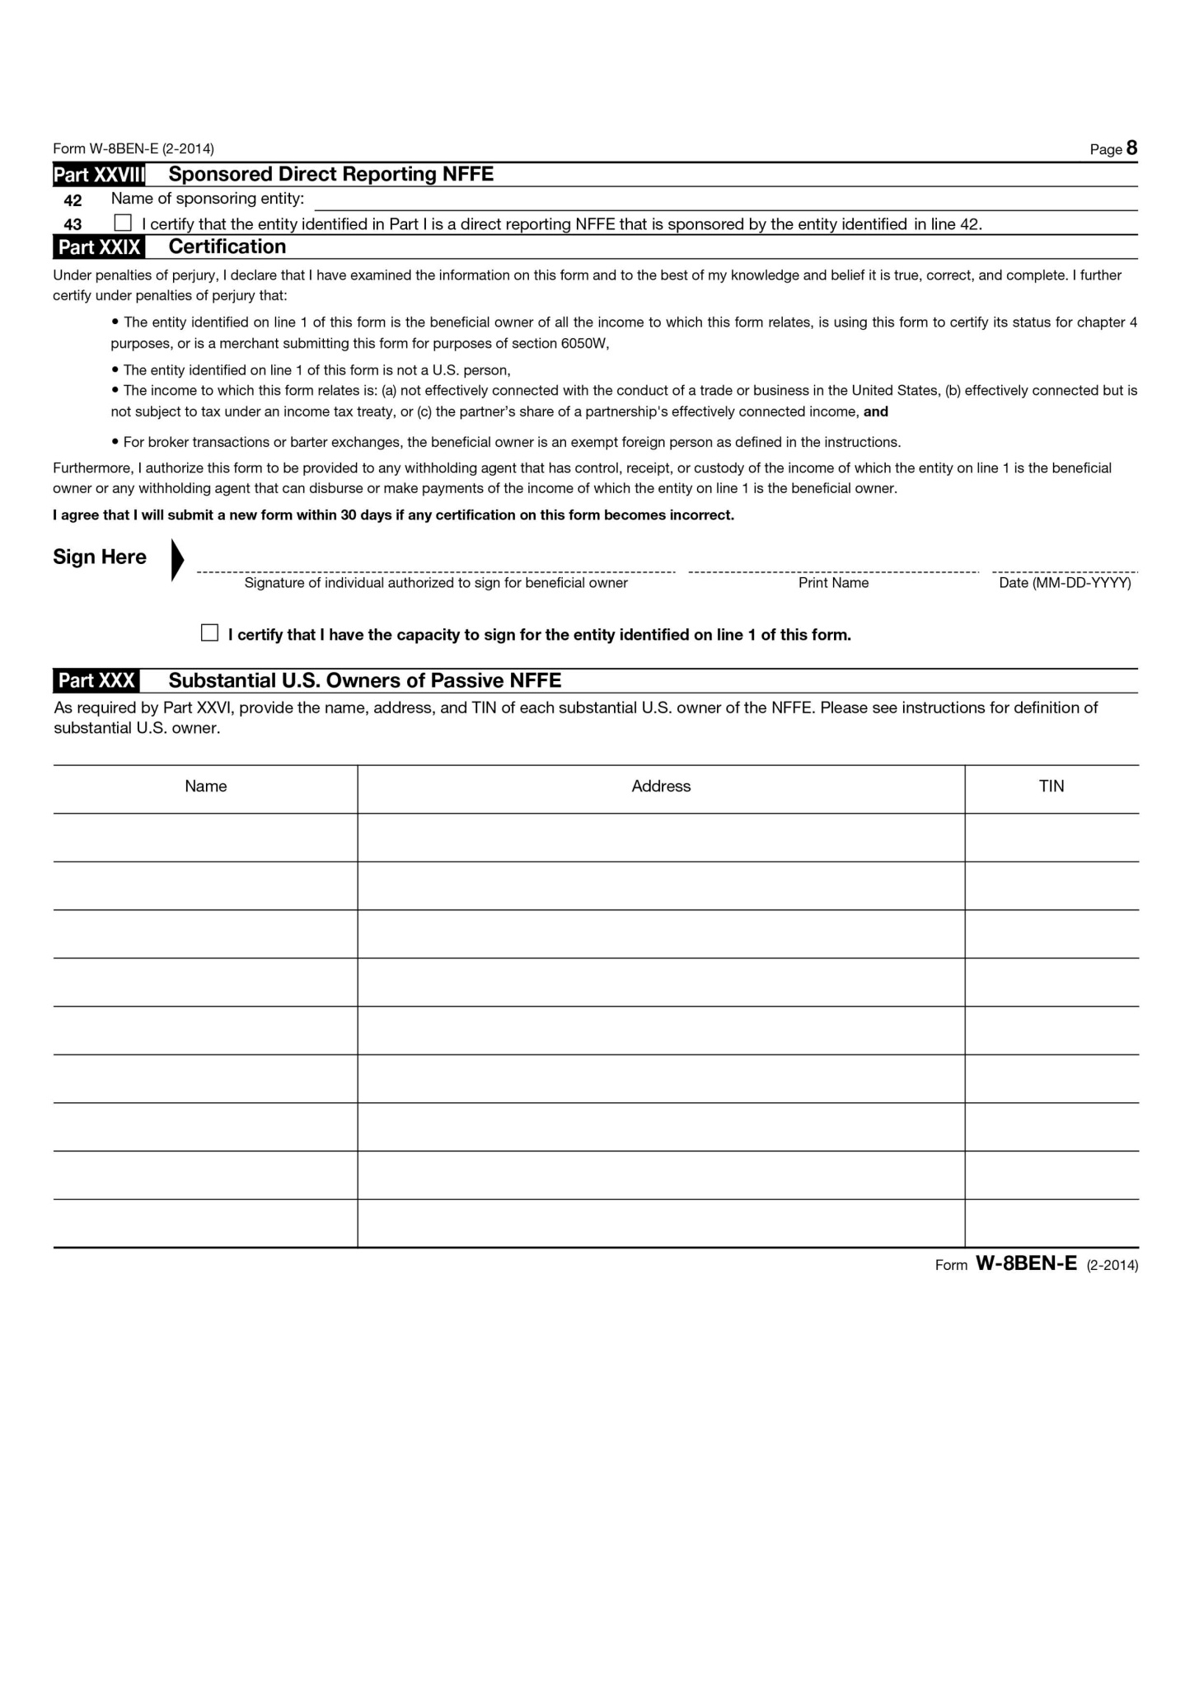
Mandatory if you have checked ”Passive NFFE” in section 5 on page 1.

