Slide 1
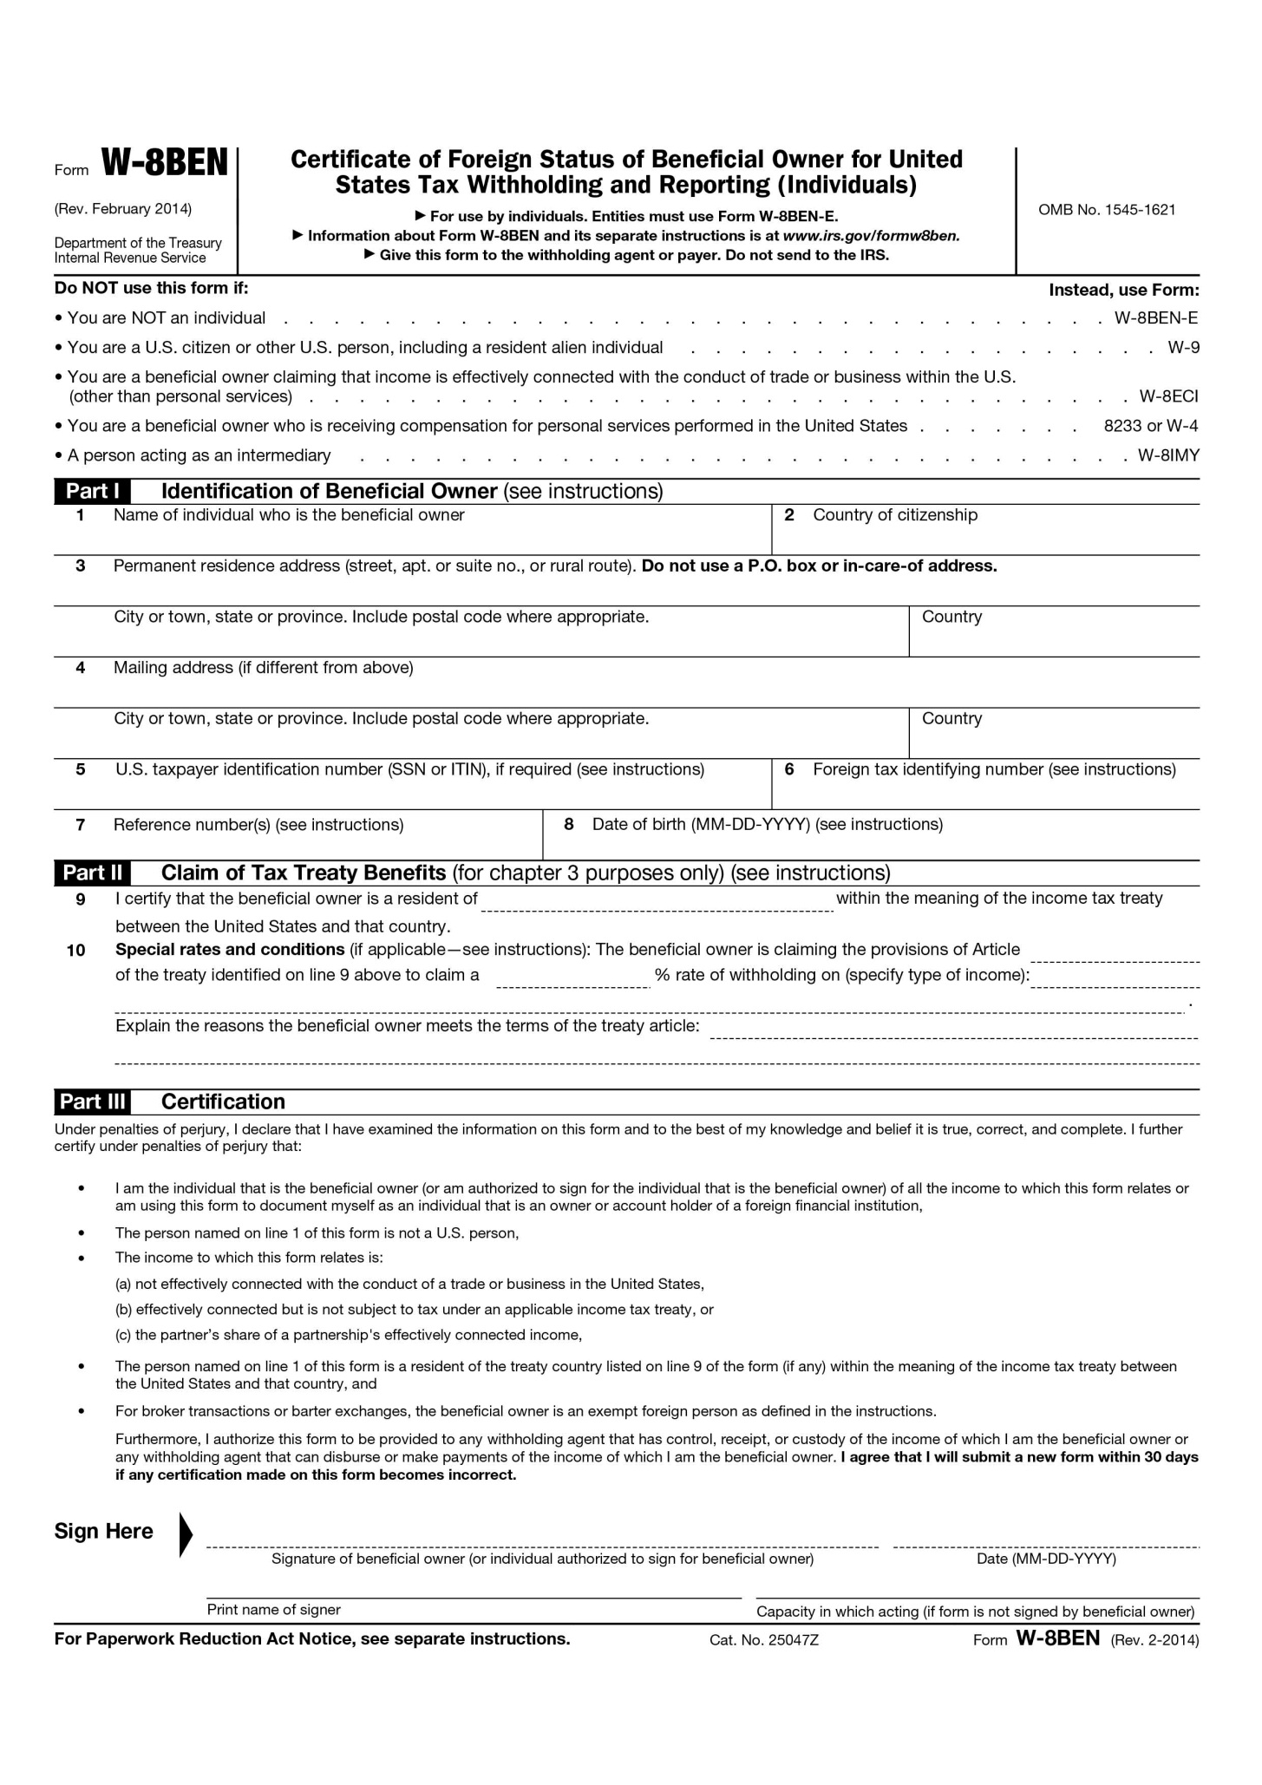
Boxes with red indicate information, which is mandatory information for FATCA

